Slide 1
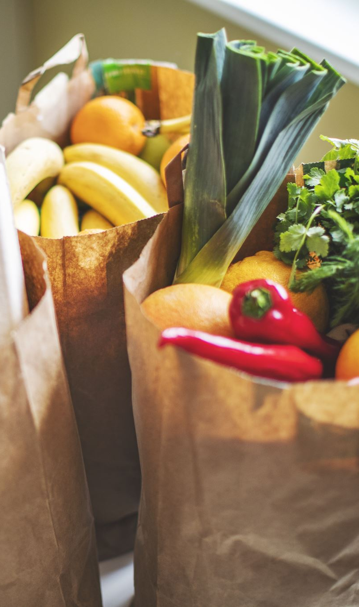
Zomato-Food delivery Insights
Niharika Miriyala

Slide 2

Q) Find customers who have never ordered
Output:

Slide 3

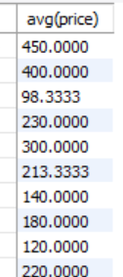
Q) Average Price/dish
Output:

Slide 4

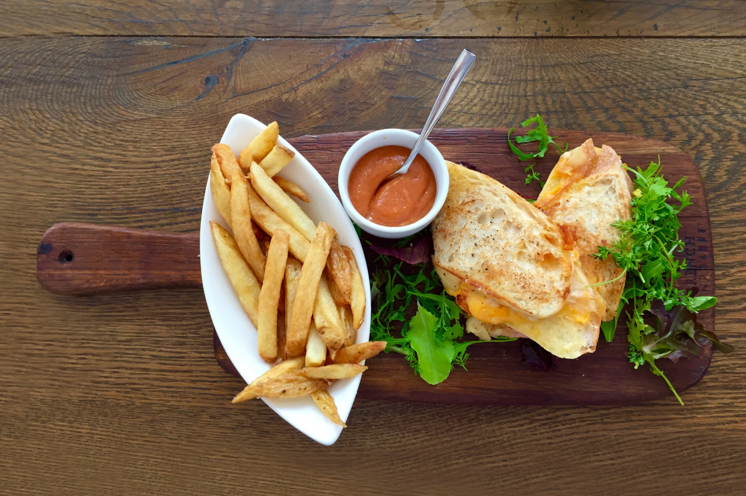
Q) Find the top restaurant in terms of the number of orders for a given month
Output:

Slide 5

Q) Restaurants with monthly sales > 500 for a given month:
Output:

Slide 6
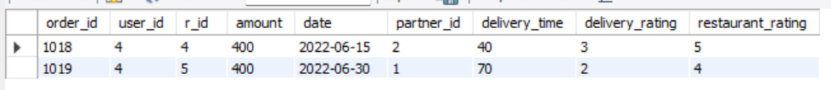

Q) Show all orders with order details for a particular customer in a particular date range:
Output:

Slide 7


Q) Find restaurants with max repeated customers
Output:
This Photo by Unknown Author is licensed under CC BY-SA-NC

Slide 8
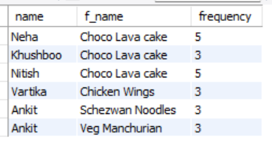
Q) Customer - favorite food
Output:

